Slide 1

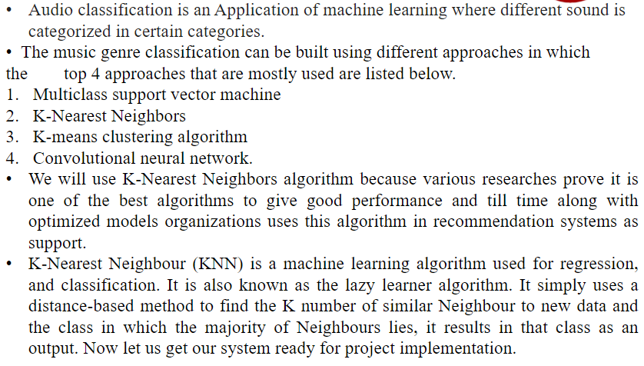
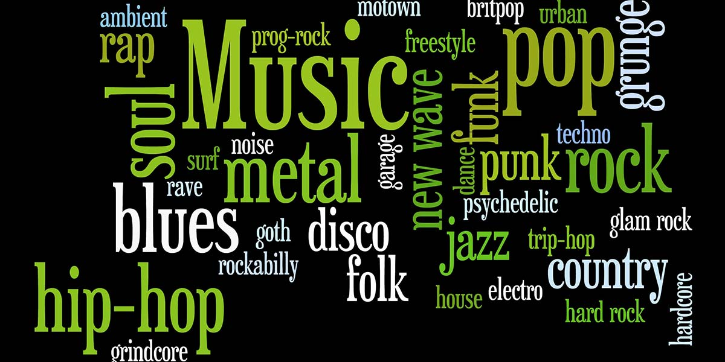
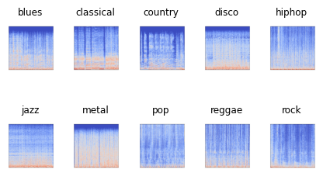
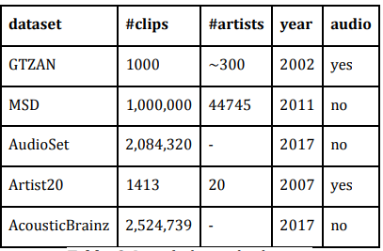
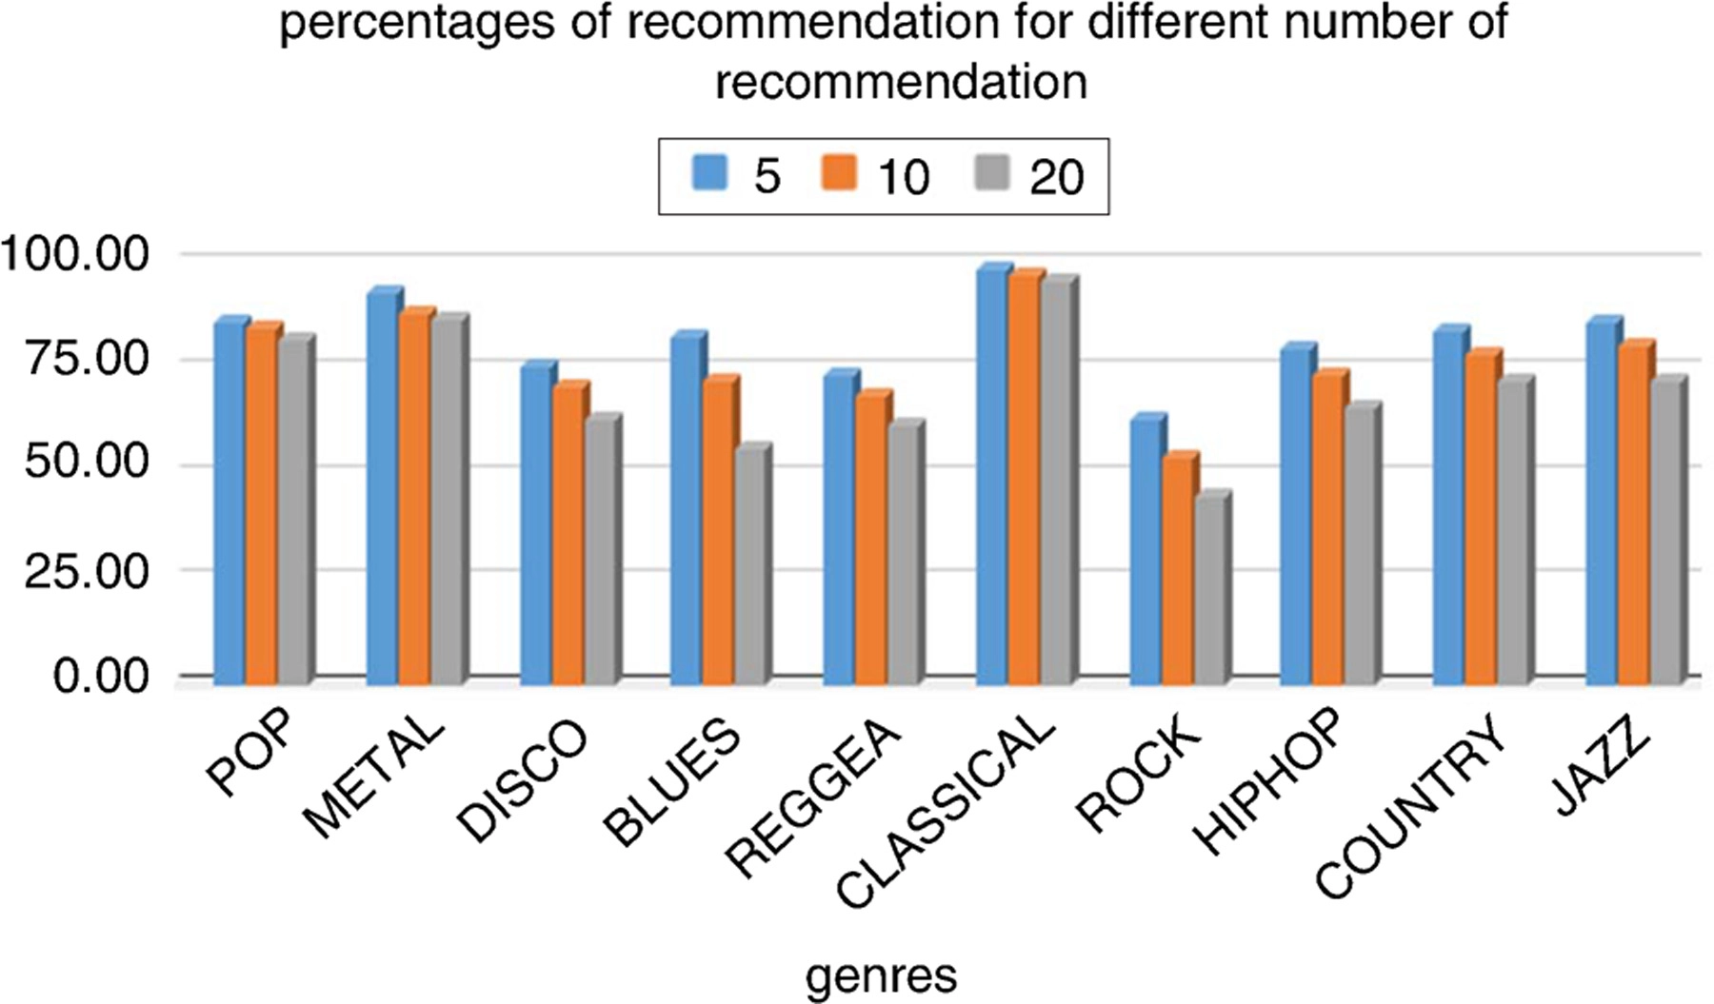
AI AUDITOR:CRAFTING YOUR PERFECT PLAYLIST WITH MACHINE LEARNING
Department of Computer Science & Engineering
School of Computing
10214CS602 – MINOR PROJECT-II
WINTER SEMESTER 2023-2024
ABSTRACT
RESULTS
STANDARDS AND POLICIES
The music industry has undergone major changes from its conventional existence and also in the form of music created in last few years. The ever-growing customer base has also increased the market for different music styles.
A music genre is a conventional category that identifies some pieces of music as belonging to a shared tradition or set of conventions.
Music can be divided into different genres in many Different ways. The popular music genres are Pop, Hip-Hop, Rock, Jazz, Blues, Country and Metal.
INTRODUCTION
The best performance in terms of accuracy is observed for the CNN model that uses only the spectrogram as an input to predict the music genre with a test accuracy of 88.54%. The CRNN model and the CNN model, however robust and complex their design is, does not give a good accuracy even though the regularization metrics are modified or the epochs are increased. The reason behind this low test accuracy rate could be the limited dataset of 8000 audio tracks. Increase in the dataset might improve the accuracy of these models.
Operating system: windows
Coding language: python
Software: Anaconda, Heroku, Android Studio
IDE: Jupiter notebook
Table : Variants of FMA dataset.
Figure 1. Music genre classification word cloud
Figure 2. Different genres in music
CONCLUSIONS
METHODOLOGIES
music genre classification is studied using the Free Music Archive small dataset. We proposed a simple approach to solving the classification problem and we drew comparisons with multiple other complex, robust models. We also compared the models based on the kind of input it was receiving. Two kinds of inputs were given to the models: Spectrogram images for CNN models and audio features stored in a csv for Logistic Regression and ANN model. Simple ANN was determined to be the best feature based classifier amongst Logistic Regression and ANN models with a test accuracy of 64%. CNN model was determined to be the best spectrogram-based model amongst CNN, CRNN and CNN-RNN parallel models, with an accuracy of 88.5%.
CNNs are one type of artiﬁcial neural network that was ﬁrst introduced by Geoffry Hinton et al. In 1986, researchers at Stanford University developed an algorithm called “Neural Gas” for solving image recognition problems. Inspired by the hierarchical and local properties of neurons in the visual cortices, convolutional neural networks (CNN) are used for image recognition tasks. Neurons usually contain multiple layers of connections between them; each layer contains different types of neurons (some fully connected, others
Convolutional).
TEAM MEMBER DETAILS
VTU19315/C.Vijaymani.
VTU19600/M.Manoj Babu.
VTU19434/RGautam
9347956001
vtu19315@veltech.edu.in
vtu19600@veltech.edu.in
vtu19434@veltech.edu.in
ACKNOWLEDGEMENT
1.Mr. S.Thylashri/ Assistant Professor
2.Project Supervisor Contact No:9843664510
3.Project Supervisor Mail Id:tylashri@veltech.edu.in
Chart 1.Recommendation demo results.

